Slide 1
Spatial Autocorrelation
Week 7: 29th April 2025
Global Moran’s I
Local Moran’s I
Getis Ord (Gi*)
HYESOP SHIN

Slide 2
Learning Objectives
Key concepts: Correlation, spatial autocorrelation, hypotheses
Know what are spatial weights
Global Moran’s I and Local Moran’s I
Four types of outcomes: HH, HL, LH, LL

Slide 3
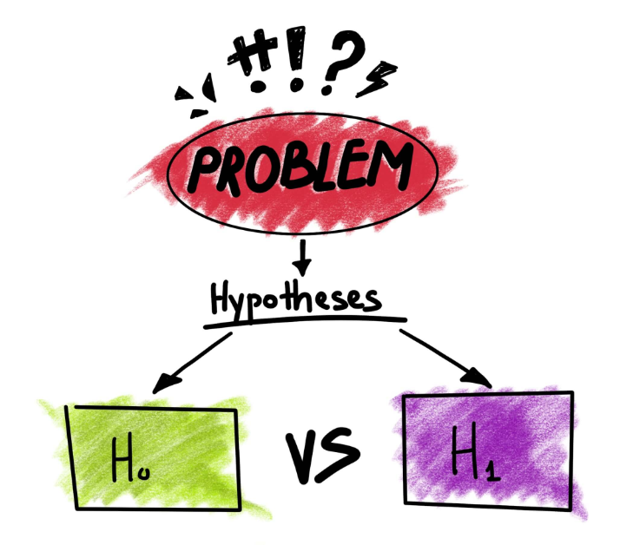
Hypothesis?
Explain what you expect to happen
Be clear and understandable
Be testable and measurable
Example: Areas with more green spaces have lower air pollution levels than areas with fewer green spaces.

Slide 4

Null & Alternative Hypothesis
Null Hypothesis (H₀)
Alternative Hypothesis (H₁)
There is no relationship between the amount of green space and air pollution levels in an area
Areas with more green spaces have lower air pollution levels than areas with fewer green spaces.

Slide 5
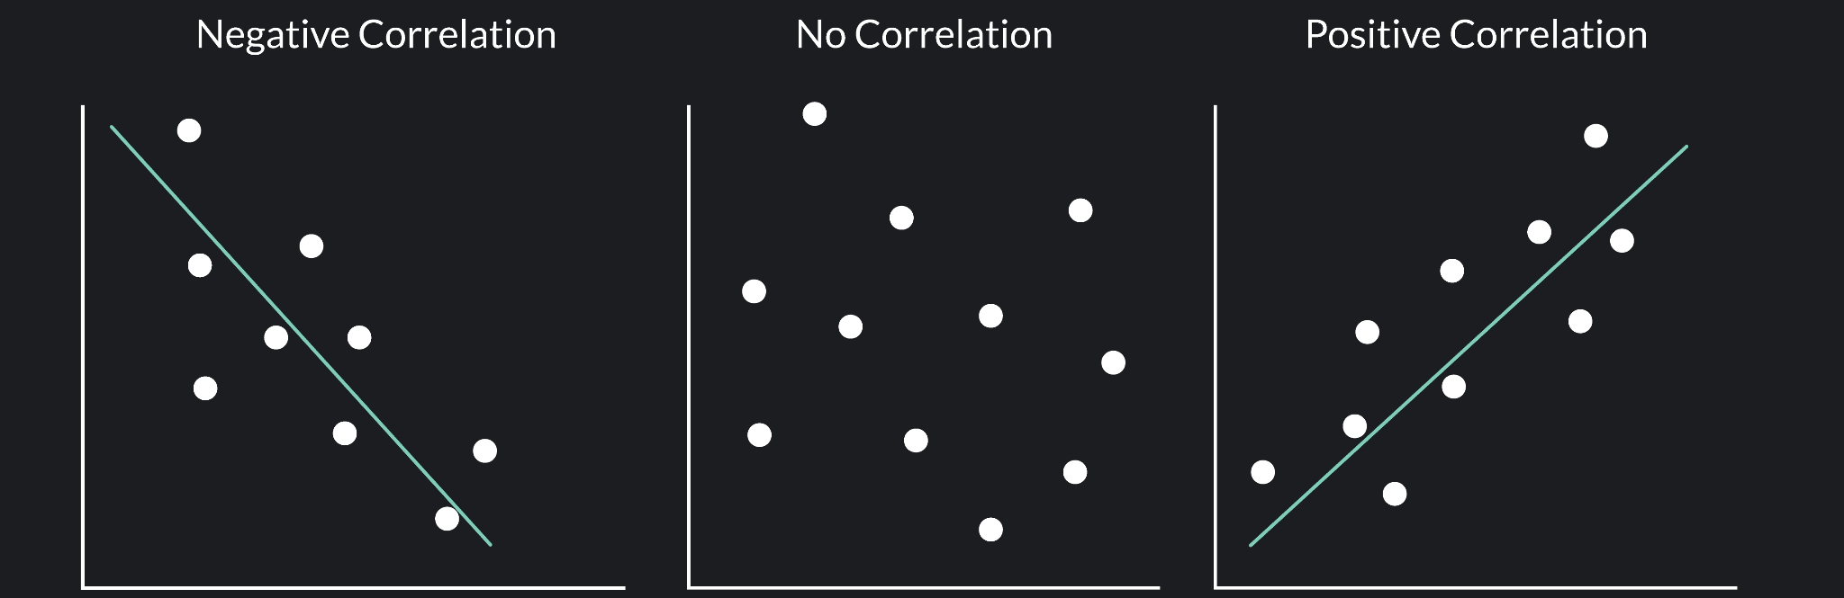

Correlation
Correlation
Correlation is a statistical measure that describes the relationship between two variables. It tells us whether an increase in one variable is associated with an increase or decrease in another.
Interest Rates x Housing prices
Temperature x Ice Cream Sales

Slide 6
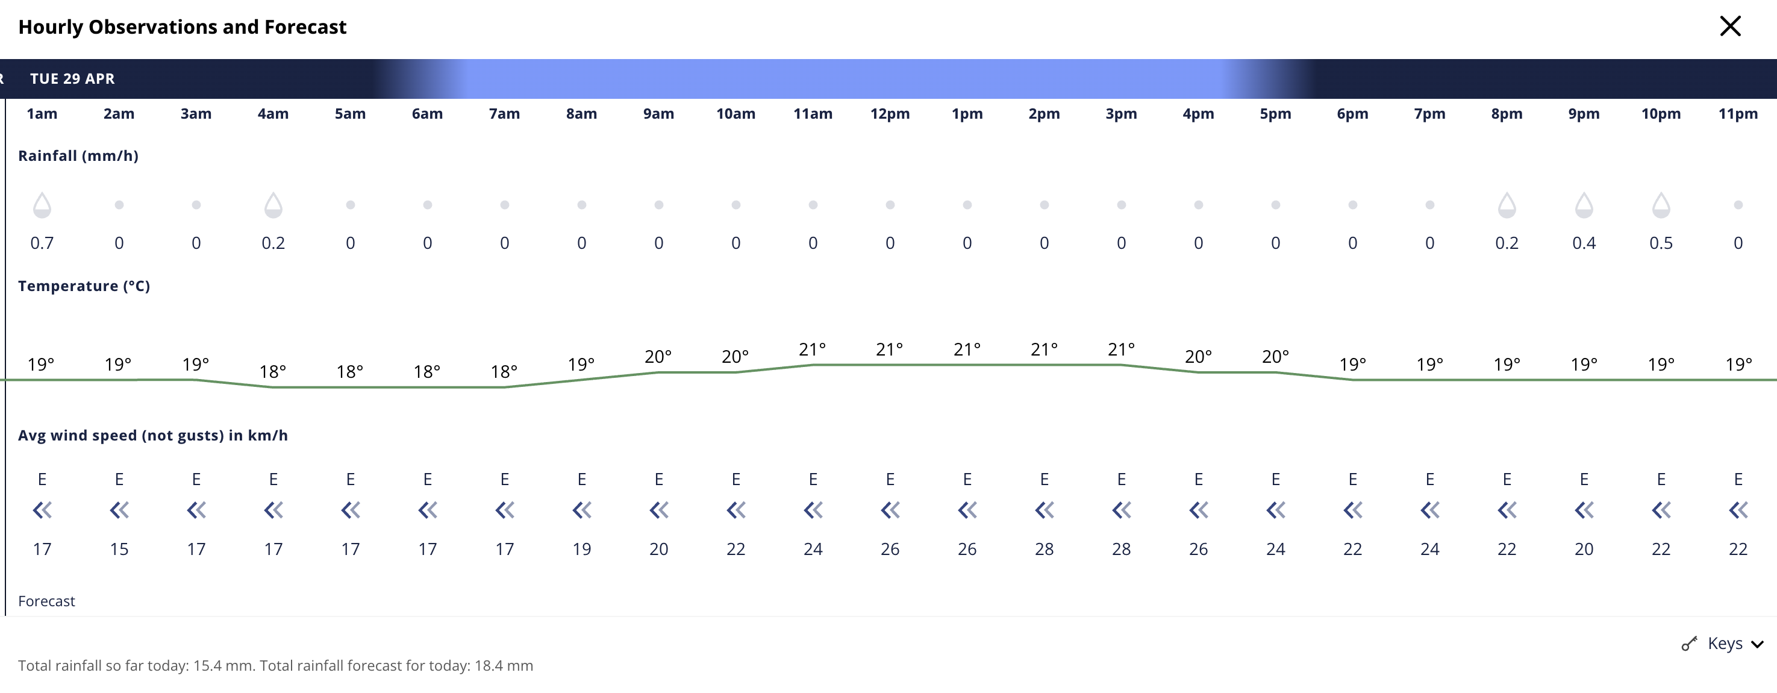
Temporal Autocorrelation?

Slide 7
Temporal Autocorrelation?
22
18
19
?
14
Early morning
Afternoon

Slide 8
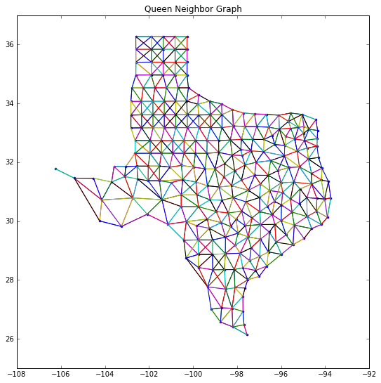
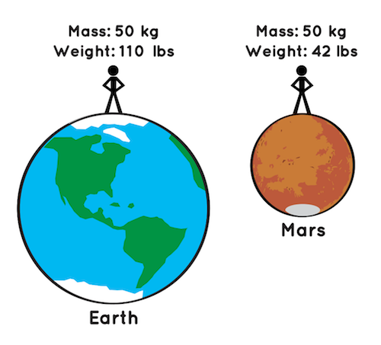
Spatial Weights
How to include “space” in statistics?

Slide 9
Spatial Weights
We need a mathematical representation of space
Geometries are spatial information but does not provide the spatial relationships
Connectedness
Proximity
But graphs do have neighbours and distances

Slide 10
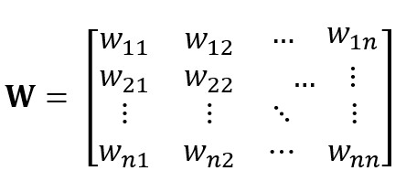

What is a graph?
In this context a graph is:
A data structure that consists of a set of objects called nodes and
A set of connections between them called edges
Notes:
For us to use this information in statistical analysis, it’s often necessary to compute these relationships between all pairs of observations. This means that, for many applications in geographic data science, we are building a topology—a mathematical structure that expresses the connectivity between observations—that we can use to examine the data.
These are spatial questions that target specific information about the spatial configuration of a specific target (“a neighborhood,” “my stalled car”) and geographically connected relevant sites (“adjacent neighborhoods”, “nearby gas stations”). For us to use this information in statistical analysis, it’s often necessary to compute these relationships between all pairs of observations.
This means that, for many applications in geographic data science, we are building a topology—a mathematical structure that expresses the connectivity between observations—that we can use to examine the data. Spatial weights matrices express this topology, letting us embed all of our observations in space together, rather than asking and answering single questions about features nearby a unit.

Slide 11
What is a neighbour?
It depends
What neighbourhoods are you surrounded by?
How many primary schools within 5km radius from my home?
We are building a topology that we can use to examine the data
Topology: a mathematical structure that expresses the connectivity between observations
Notes:
For us to use this information in statistical analysis, it’s often necessary to compute these relationships between all pairs of observations. This means that, for many applications in geographic data science, we are building a topology—a mathematical structure that expresses the connectivity between observations—that we can use to examine the data.
These are spatial questions that target specific information about the spatial configuration of a specific target (“a neighborhood,” “my stalled car”) and geographically connected relevant sites (“adjacent neighborhoods”, “nearby gas stations”). For us to use this information in statistical analysis, it’s often necessary to compute these relationships between all pairs of observations.
This means that, for many applications in geographic data science, we are building a topology—a mathematical structure that expresses the connectivity between observations—that we can use to examine the data. Spatial weights matrices express this topology, letting us embed all of our observations in space together, rather than asking and answering single questions about features nearby a unit.

Slide 12
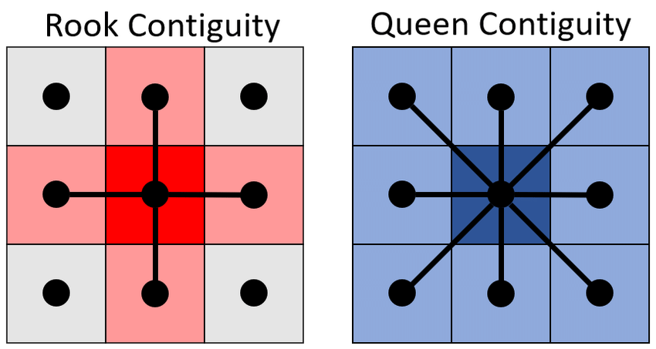
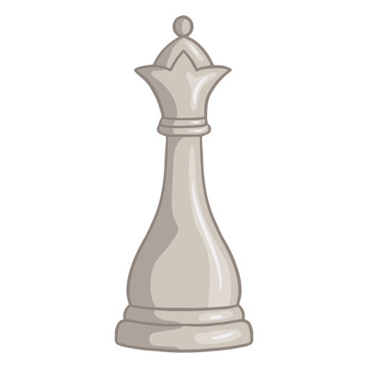

Contiguity
Contiguity means that two spatial units share a common border of non-zero length
Notes:
Two geometries are considered neighbours if they share at least one vertex (queen contiguity)
or one edge (rook contiguity).

Slide 13
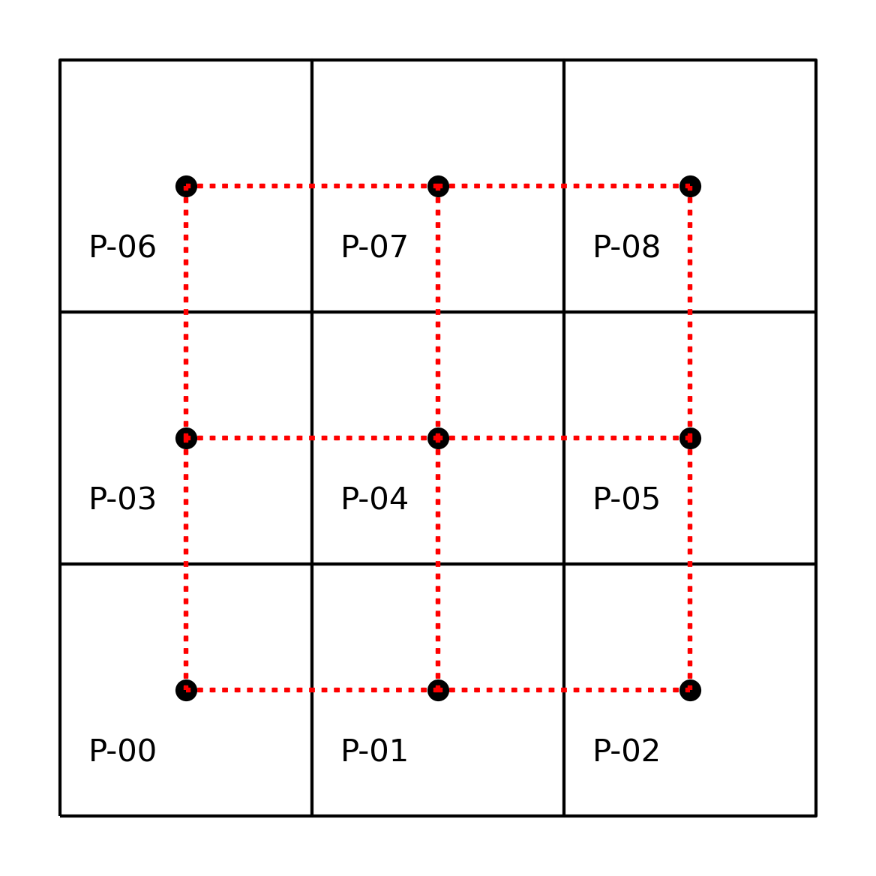
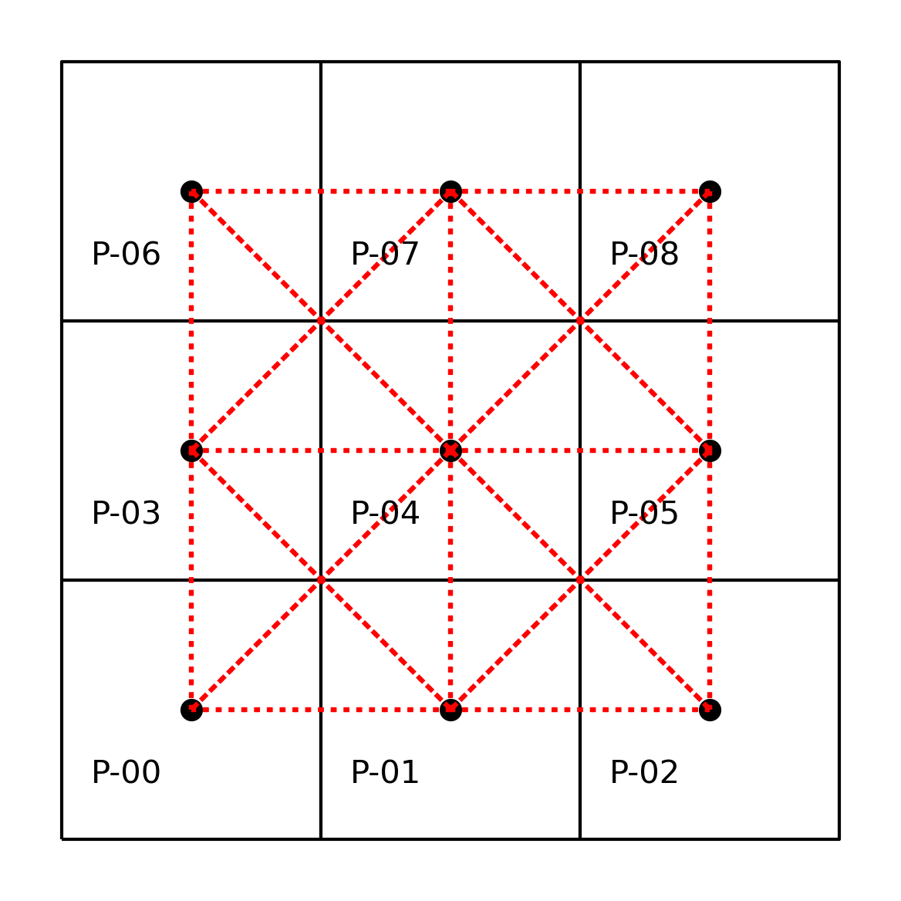
Graph Visualisation
Rook
Queen
Notes:
More generally, the spatial weights for our 3-by-3 grid can be represented as a matrix that has 9 rows and 9 columns, matching the number of polygons (n=9). An important thing to note is that geography has more than one dimension. When compared to common representations of relationships in time used in data science, using information about spatial relationships can be more complex: spatial relationships are bi-directional, while temporal relationships are unidirectional.

Slide 14
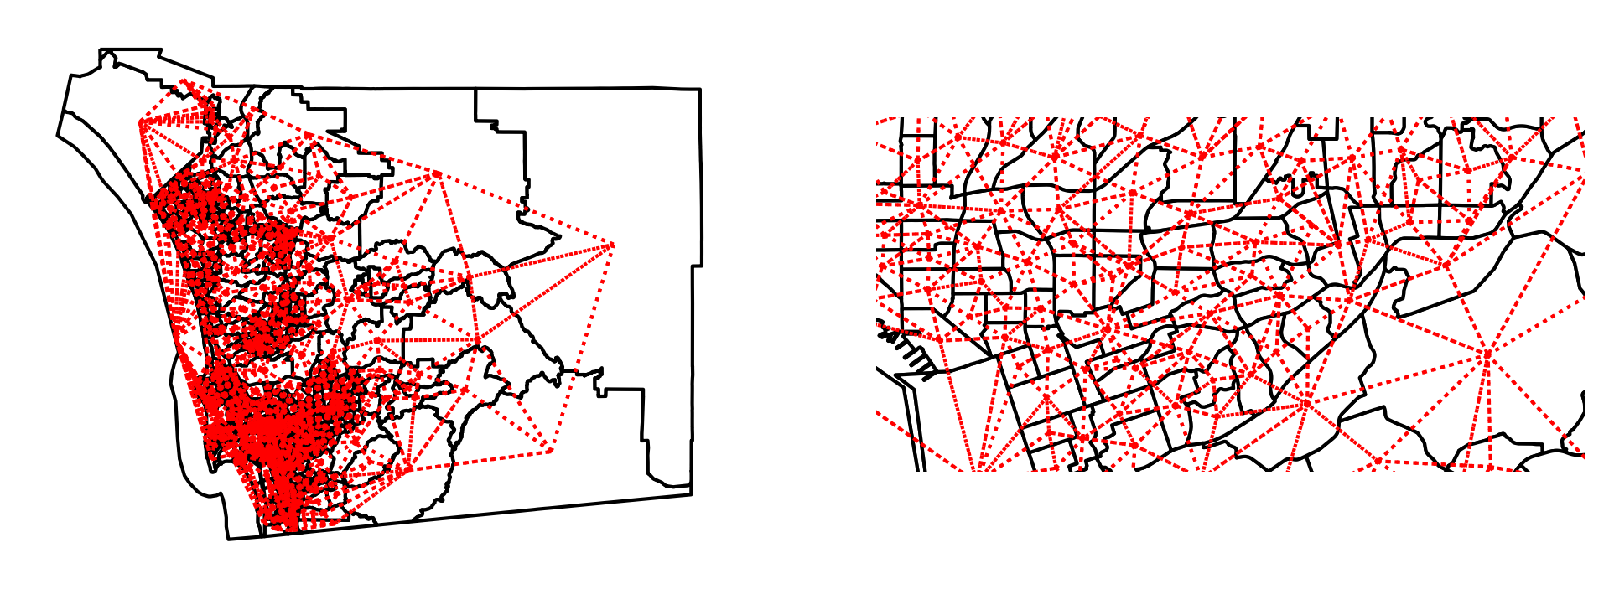
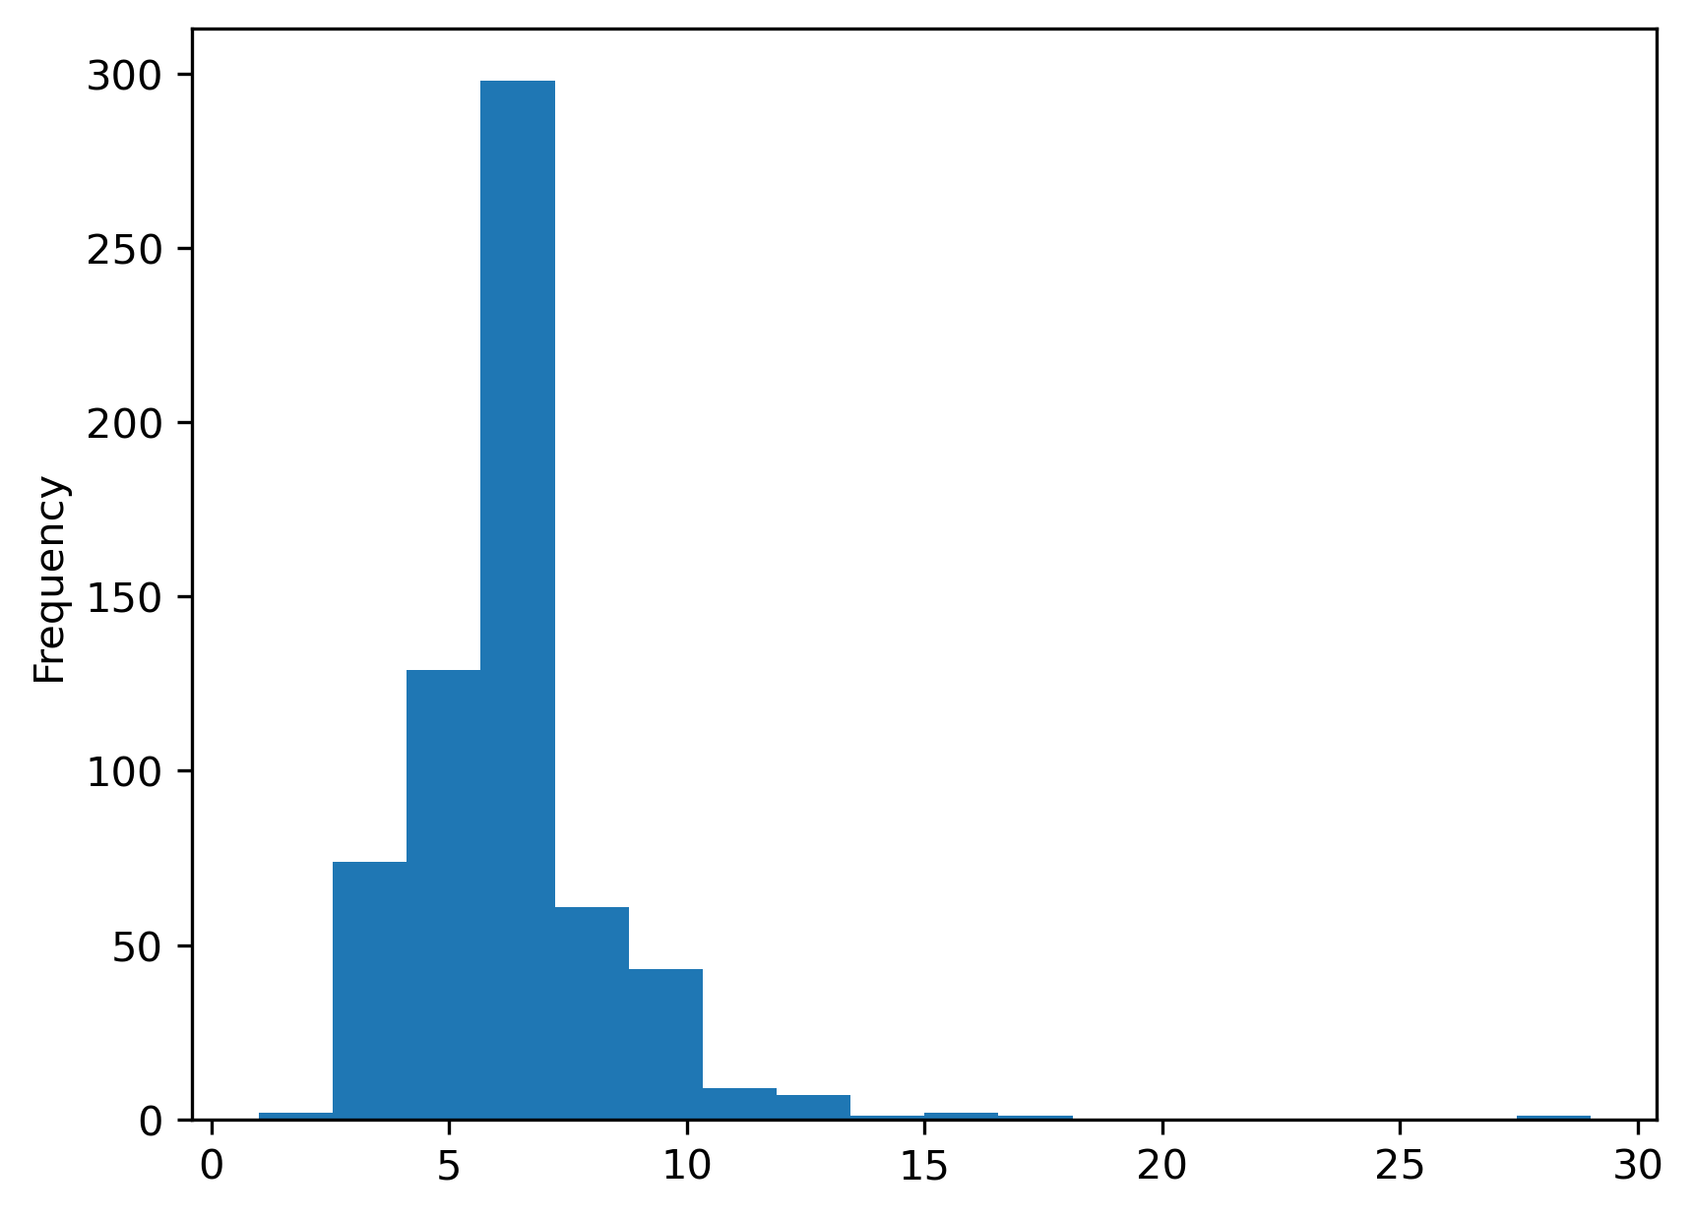
Spatial weights from real-world geographic tables
Queen Contiguity
San Diego census tract

Slide 15
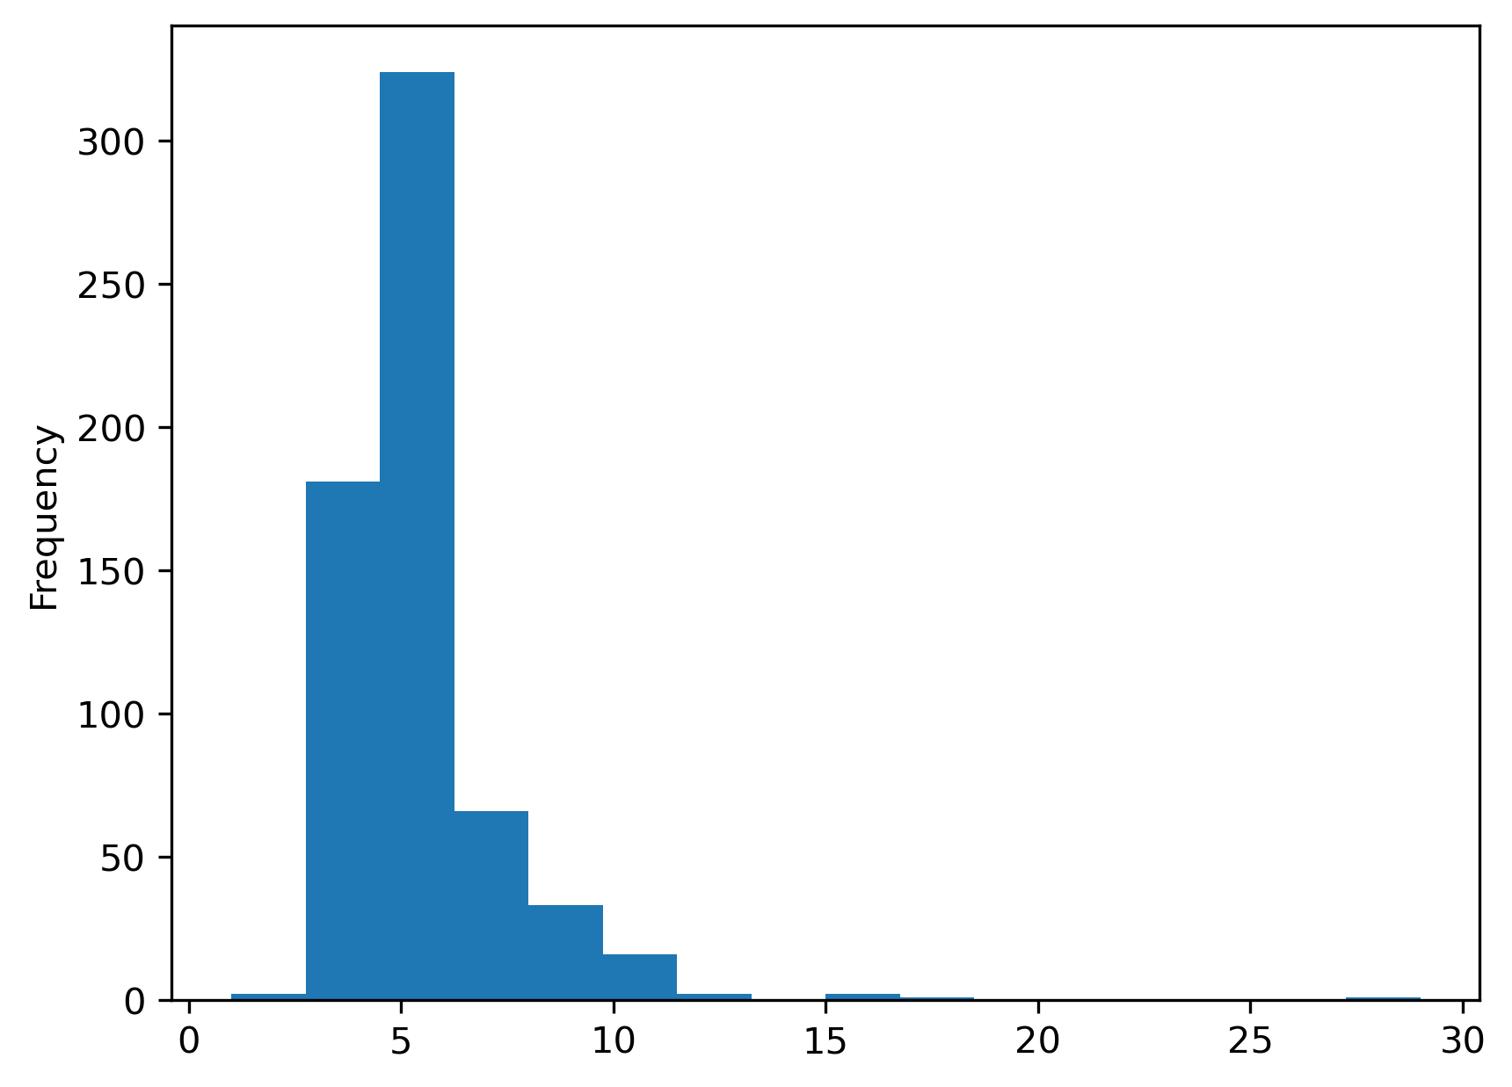
Spatial weights from real-world geographic tables
Rook Contiguity
San Diego census tract

Slide 16
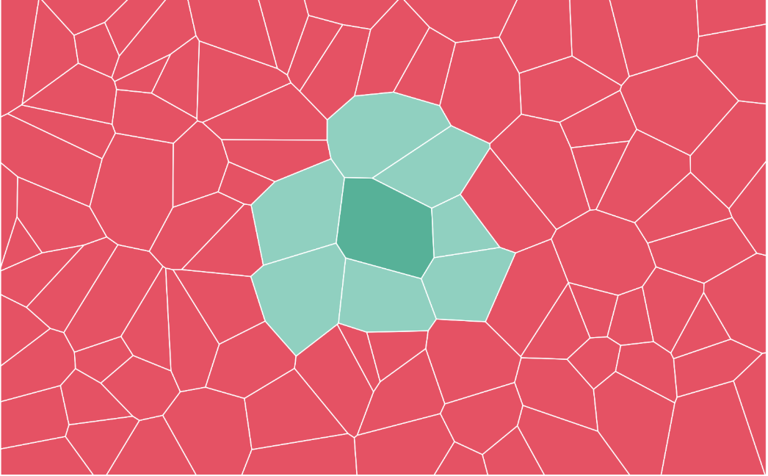
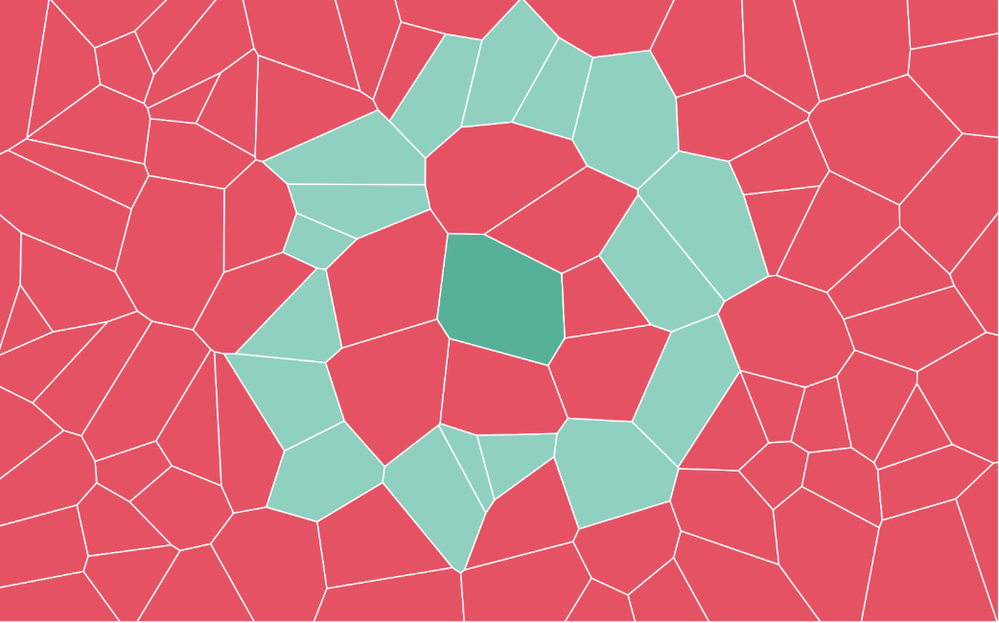
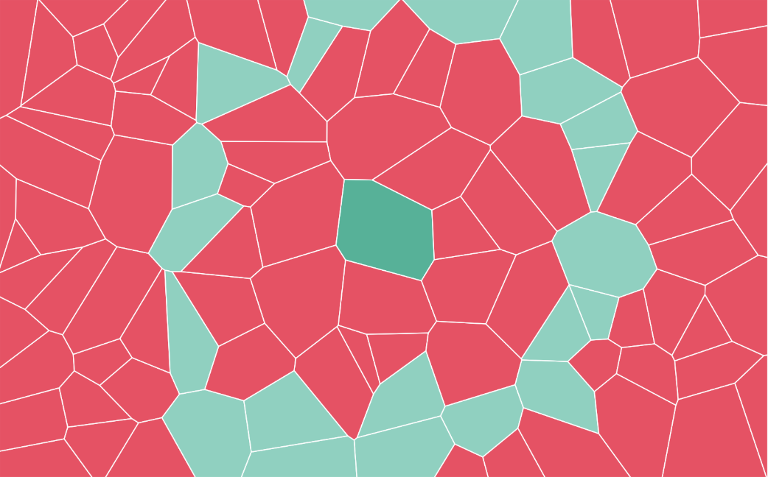
Order of Contiguity
1st order contiguity
2nd order contiguity
3rd order contiguity

Slide 17
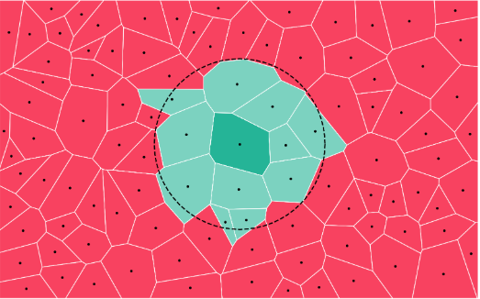
Distance-based
Neighbours can be defined by distances
Two geometries are considered neighbours if they lie within a set threshold from each other

Slide 18
Spatial Autocorrelation

Slide 19
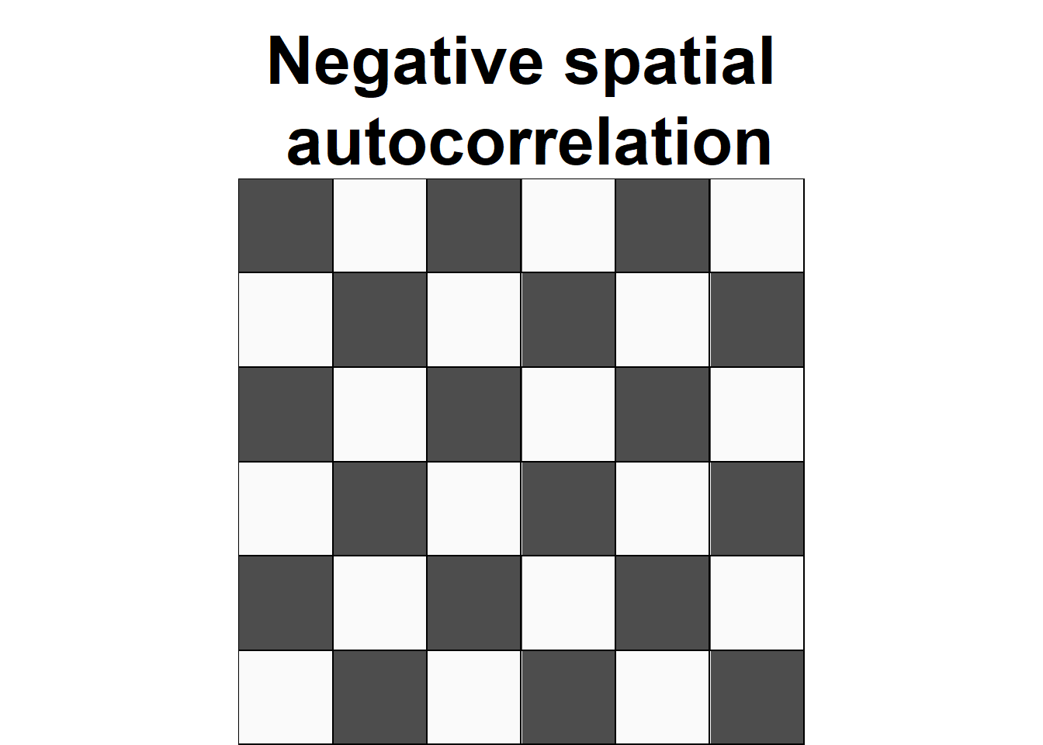
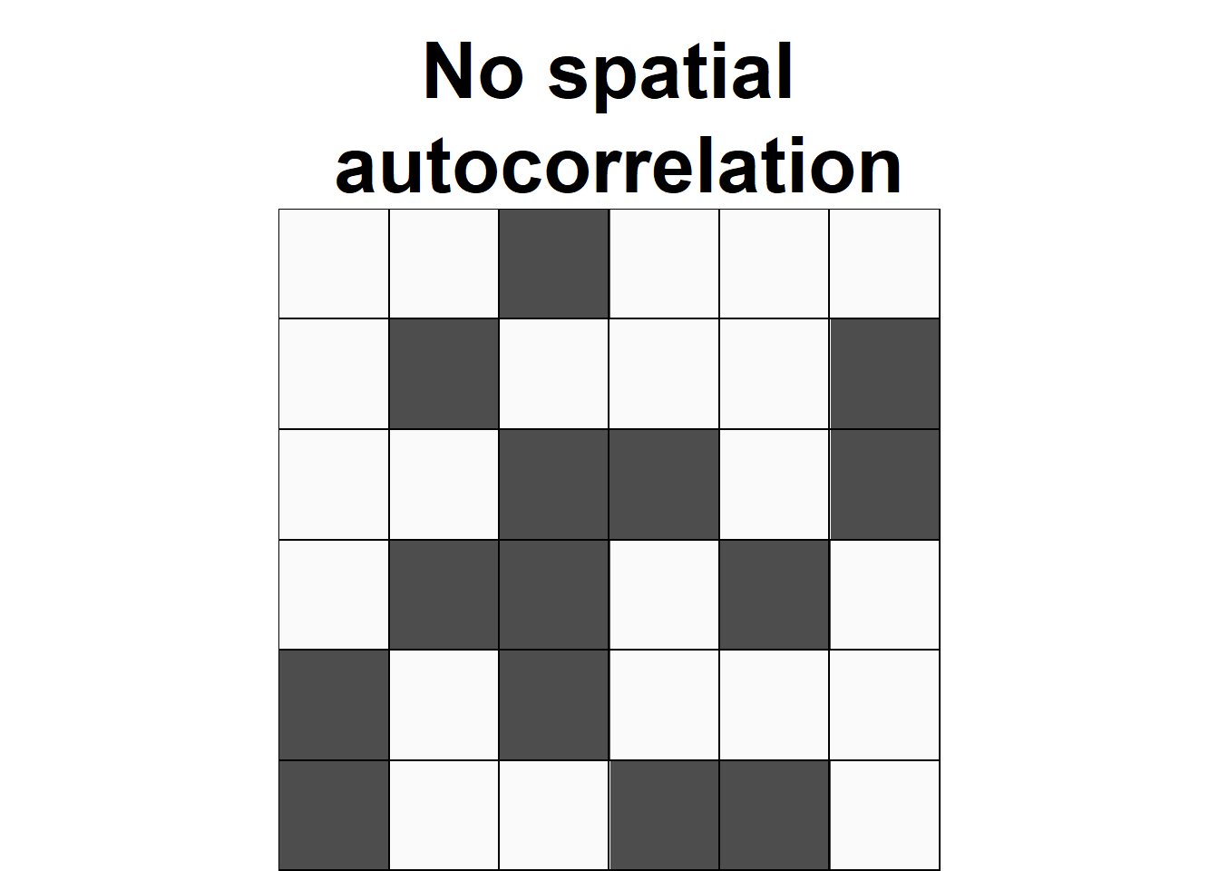
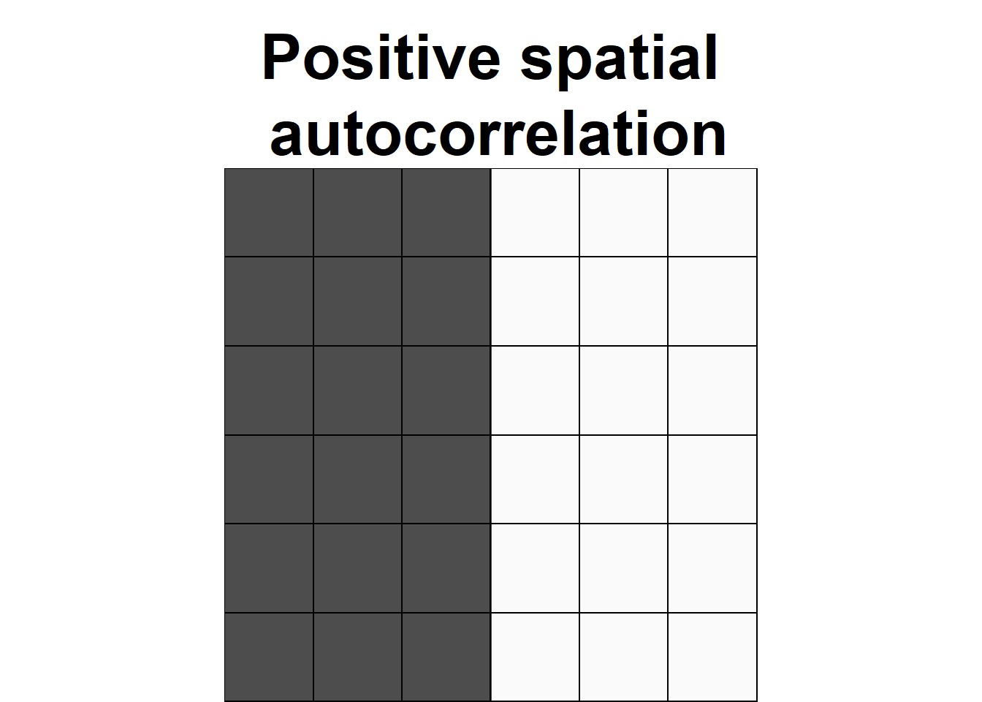
Spatial “auto”correlation
Everything is related to everything else, but near things are more related than distant things (Waldo Tobler, 1970).
Degree to which similar values are located in similar locations
Similar values → dissimilar location (further apart)
Random
Similar values → similar location (closeby)
Notes:
Spatial autocorrelation extends the idea of correlation to geographical space. It examines whether similar values are clustered together in space or are randomly distributed.
Positive spatial autocorrelation: Nearby locations have similar values.
Example: High air pollution levels in one city are often surrounded by high pollution levels in neighboring cities.
Negative spatial autocorrelation: Nearby locations have opposite values.
Example: A rich neighborhood surrounded by poorer areas.
No spatial autocorrelation: Values are randomly distributed.
Example: If crime incidents were randomly spread across a city with no pattern.

Slide 20
Example
Positive SA
Negative SA
Income
Poverty
Vegetation
Temperature
Supermarkets
Police stations
Fire stations
Hospitals…
Notes:
Income
→ High-income neighbourhoods are often located near other high-income areas (HH), while low-income areas cluster together (LL).
Example: Affluent suburbs surrounding central business districts.
Poverty
→ Areas with high poverty rates are often adjacent to other disadvantaged areas.
Example: Inner-city zones with historical disinvestment showing concentrated poverty.
Vegetation
→ Forested regions or green spaces typically span across multiple adjacent areas.
Example: National parks or river corridors with contiguous vegetation coverage.
Temperature
→ Warmer or cooler temperatures tend to cluster spatially due to elevation or urban heat effects.
Example: Urban heat islands where city centers are hotter than surrounding suburbs.
—----------
Negative spatial autocorrelation
Supermarkets
→ Usually evenly spread across a city to reach different residential areas.
→ Negative autocorrelation: a new one is likely located where there isn't one nearby.
Police stations / Fire stations
→ Designed to cover service areas and minimize response times.
→ Negative autocorrelation due to intentional spacing.
Hospitals
→ Large regional hospitals are spatially separated to serve different catchments.
→ Again, negative autocorrelation is common.

Slide 21
Scales
[Global]
Clustering: do values tend to be close to other (dis)similar values?
[Local]
Clusters: are there any specific parts of a map with an extraordinary concentration of (dis)similar values?

Slide 22
Global Spatial Autocorrelation
“Clustering”
Overall trend where the distribution of values follows a particular pattern over space
The premise is to understand how similar are you compared to your neighbourhood
The null hypothesis assumes spatial randomness — that there is no spatial autocorrelation in the data.
[Positive] Similar values close to each other (high-high, low-low)
[Negative] Similar values far from each other (high-low)
How do we measure it?

Slide 23
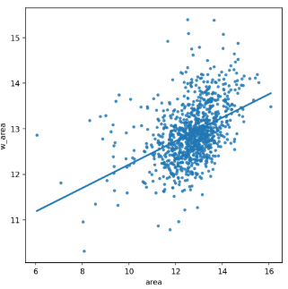
Moran Plot
Graphical device that displays a variable on the horizontal axis against its spatial lag* on the vertical one
Assessment of the overall association between a variable in a given location and in its neighbourhood
*Spatial lag: the average value of the variable at neighbouring locations)

Slide 24
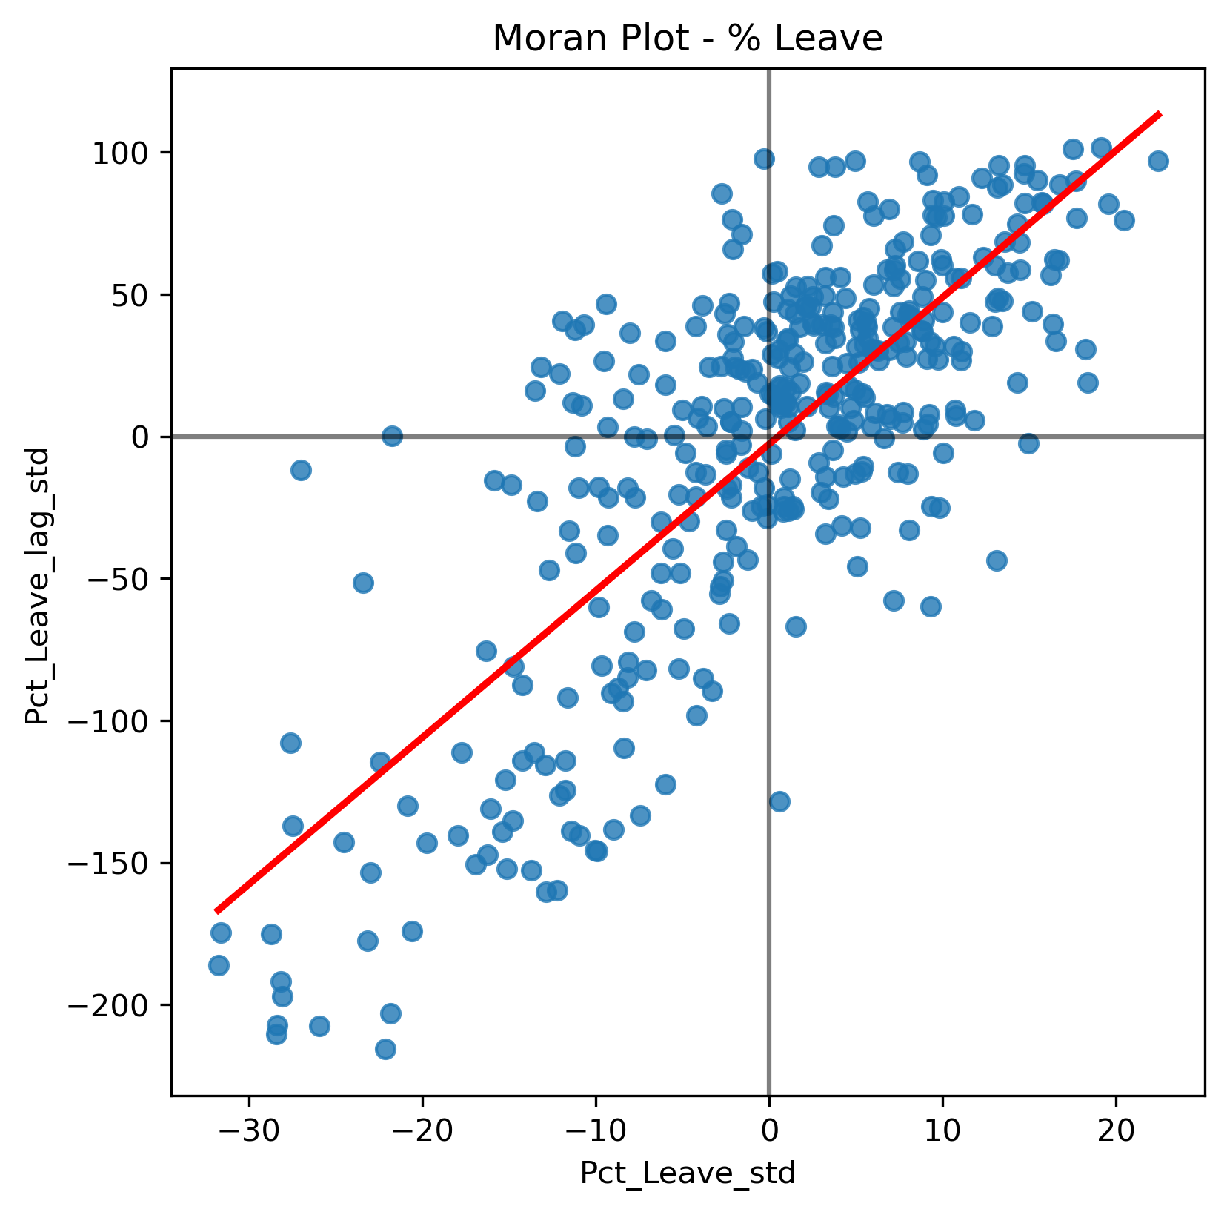
Moran’s I
Formal test of global spatial autocorrelation
Statistically identify the presence of clustering in a variable
Slope of the Moran plot
Inference based on how likely it is to obtain a map like observed from a purely random pattern
Value Range: 0 and 1

Slide 25
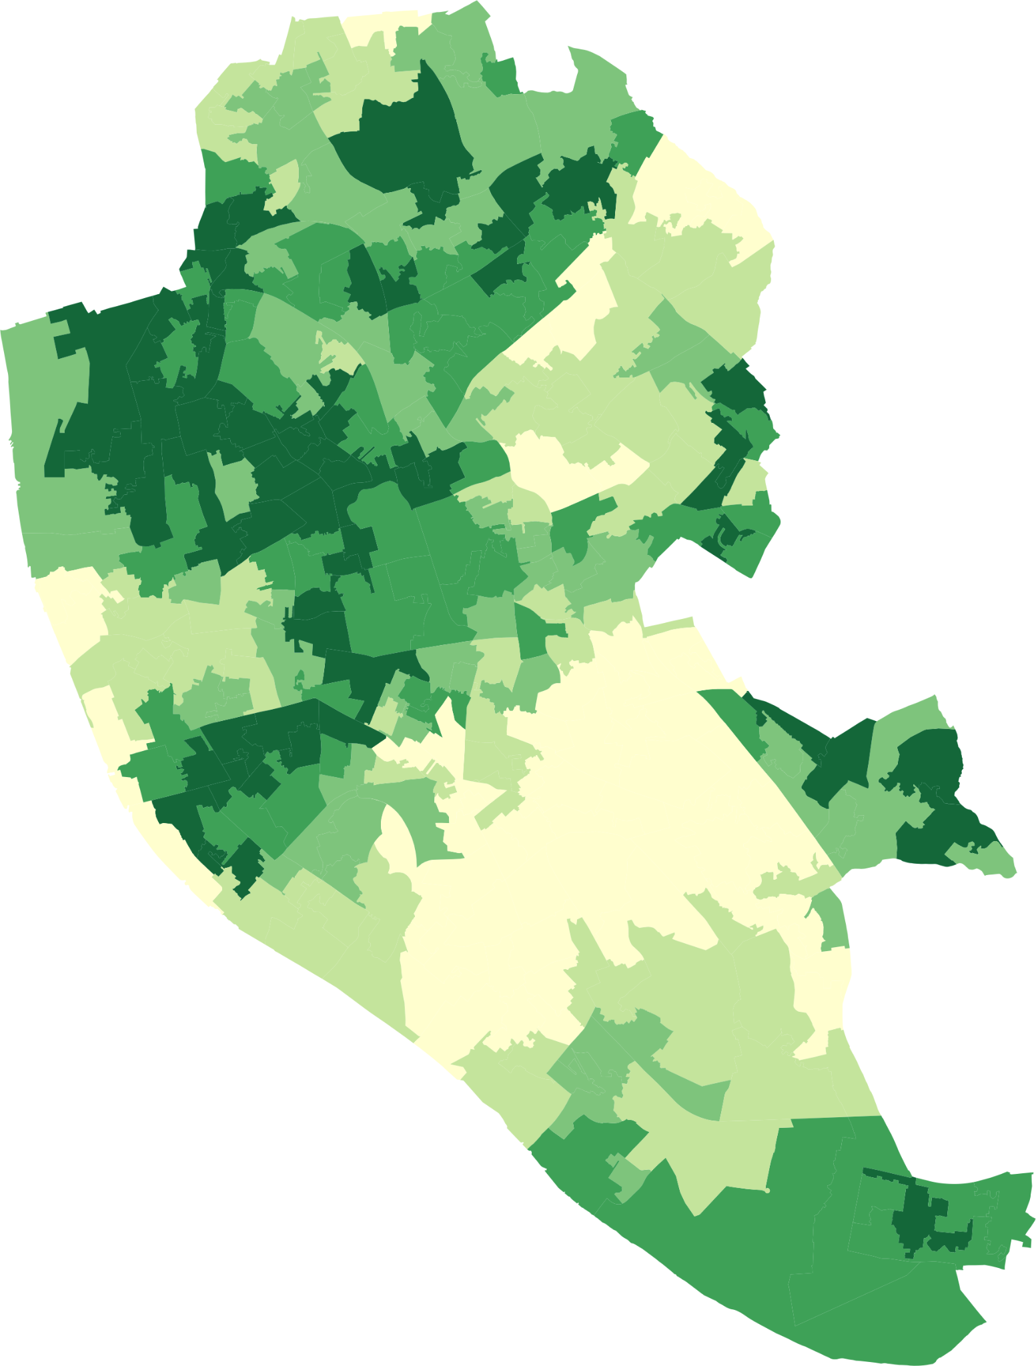
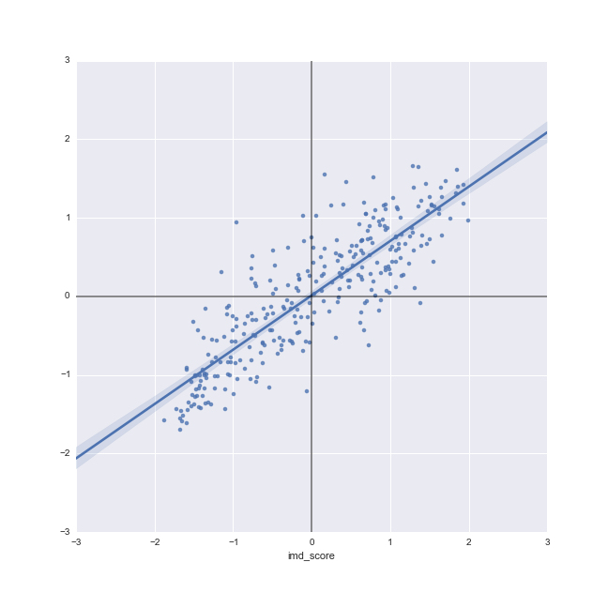
Graphic illustration

Slide 26
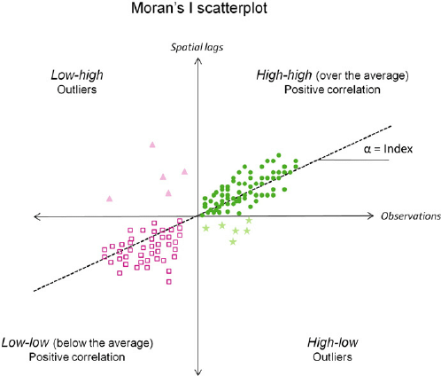
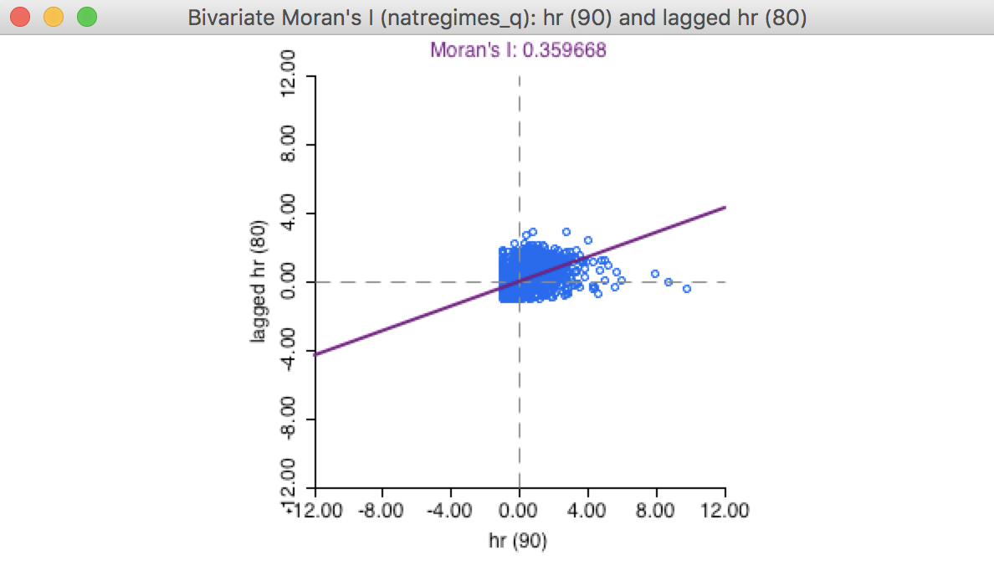
I statistics
I values between 0 and 1

Slide 27
How do we compute Moran’s I?

Slide 28

Get your Choropleth map ready

Slide 29
Moran’s I
1. State the null and alternative hypotheses
2. Calculate Queen contiguity
Steps
3. Extract NZDep variable
4. Standardise weights
5. Calculate Moran’s I (and look at the p-value)
If p-value < α, we reject the null hypothesis.
If p-value ≥ α, we fail to reject the null hypothesis
Notes:
State the null and alternative hypotheses:
Choose the significance level α we are willing to tolerate, which represents the maximum value for the probability of incorrectly rejecting the null hypothesis when it is true (usually α=0.05).
Calculate the test statistic Z
Find the p-value for the observed data by comparing the z-score to the standard normal distribution or via Monte Carlo randomization. The p-value is the probability of obtaining a test statistic as extreme as or more extreme than the one observed test statistic in the direction of the alternative hypothesis, assuming the null hypothesis is true.
Make one of these two decisions and state a conclusion:
If p-value < α, we reject the null hypothesis. We conclude data provide evidence for the alternative hypothesis.
If p-value ≥ α, we fail to reject the null hypothesis. The data do not provide evidence for the alternative hypothesis.

Slide 30
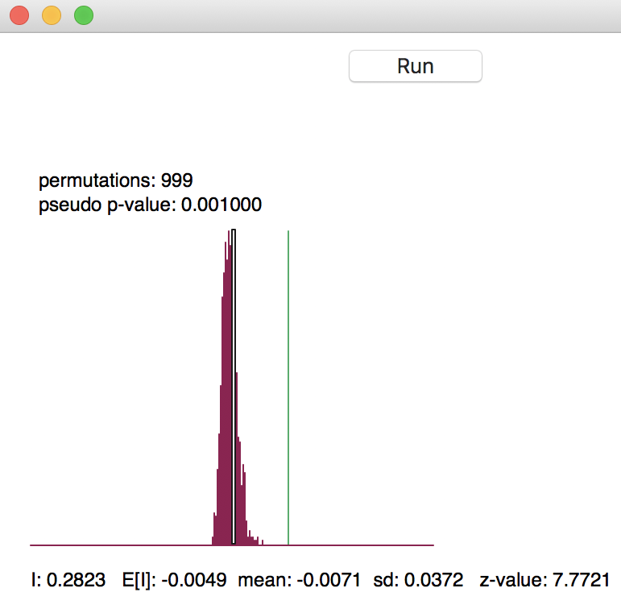
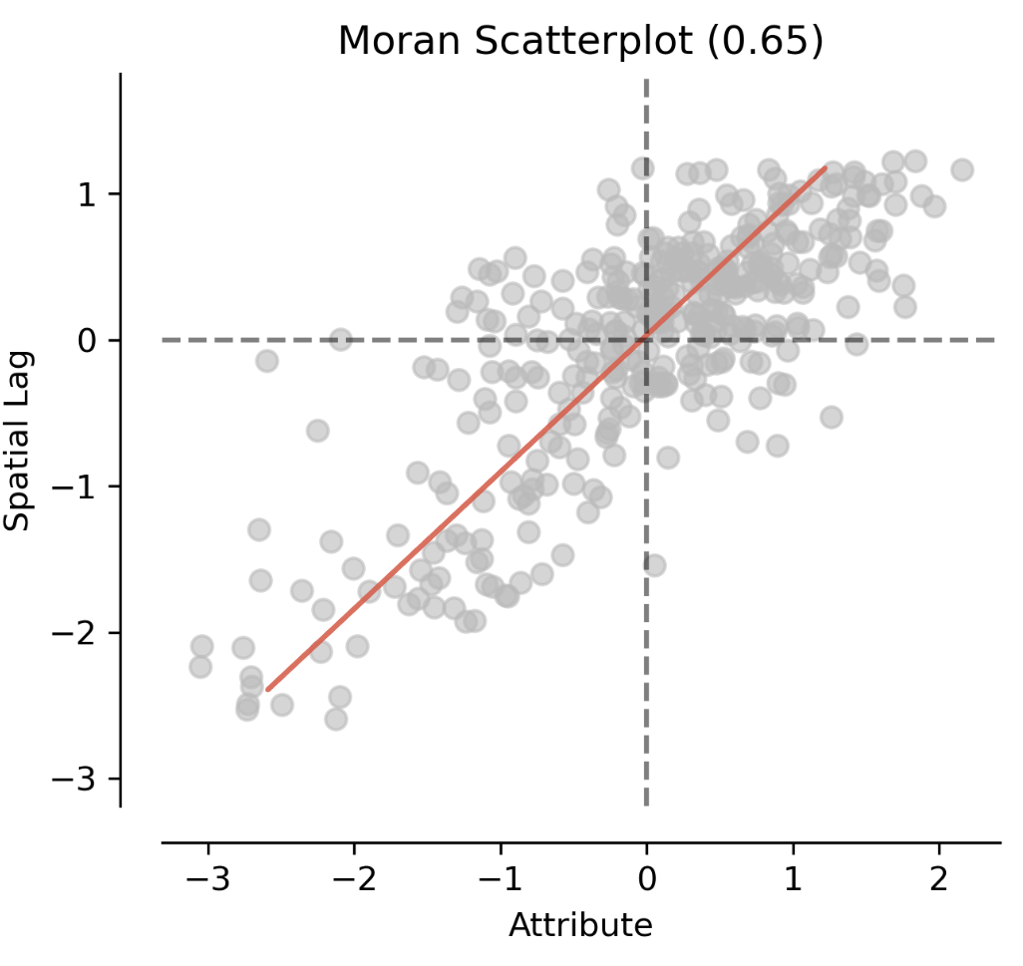
Check hypothesis: Permutation
Permutation (randomly distributing)
Permutations can be 9, 99, and 999
Checks how much the analysed I are different to the permuted results
Permuted: Histogram
Green: your Global moran’s I
Statistically significant

Slide 31
Limitations of Global Spatial Autocorrelation (e.g., Moran’s I)
Global statistics like Moran’s I summarise spatial patterns across the entire map.
Moran’s I captures overall clustering (positive values) or dispersion (negative values) in your dataset. However, it does not tell you where clustering or dispersion occurs.
🧭 Think of it like getting an average temperature for a country – useful, but it doesn’t tell you where the heatwaves or cold spots are!
To identify specific local patterns (e.g., clusters of high or low values), we need local spatial statistics (e.g., Local Moran’s I or Getis-Ord Gi*).

Slide 32
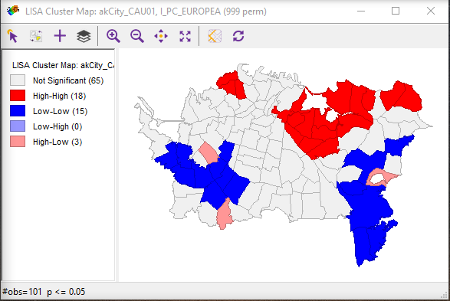
Local Moran’s I
Local measures of spatial autocorrelation focus on the relationships between each observation and its surroundings
Also known as Local Indicators of Spatial Association (LISA) (Anselin 1995)
Clusters
High-High
Positive SA of high values (hotspots)
Low-Low
Positive SA of low values (coldspots)
High-Low
Negative SA (spatial outliers)
Low-High
Negative SA (spatial outliers)
Notes:
Designed to provide an indication of the extent of significant spatial clustering of similar values around each observation.
Also known as Local Indicators of Spatial Association (LISA) (Anselin 1995)
The sum of the LISA’s values across all regions is equal to a multiple of the global indicator of spatial association.

Slide 33
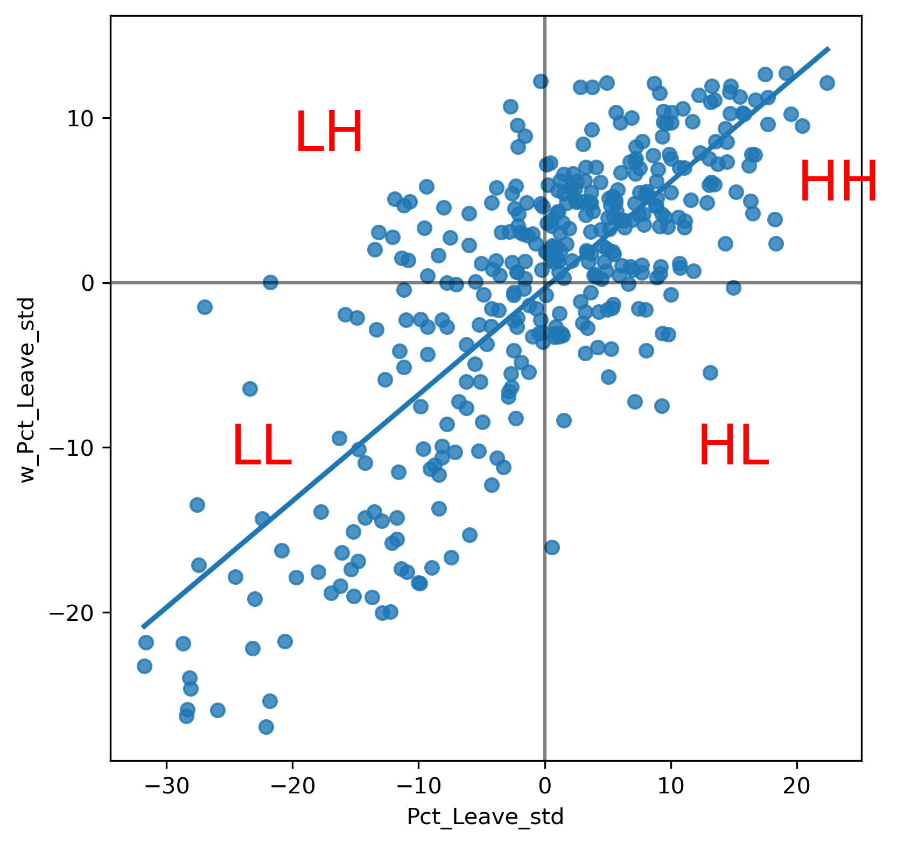
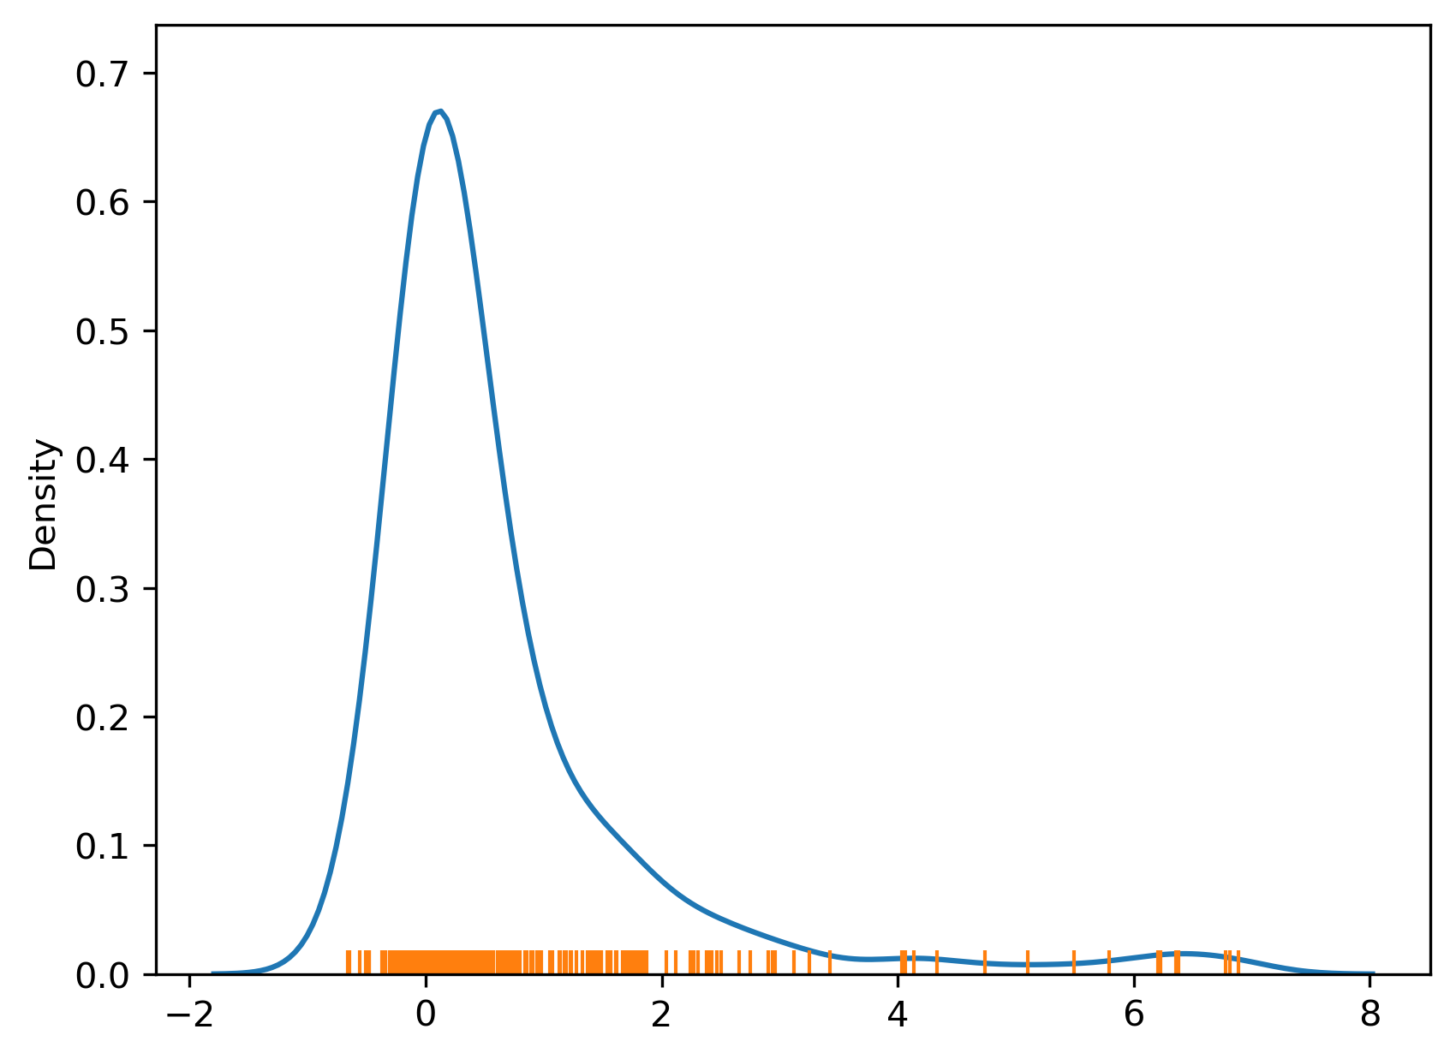
Example: UK Referendum

Slide 34
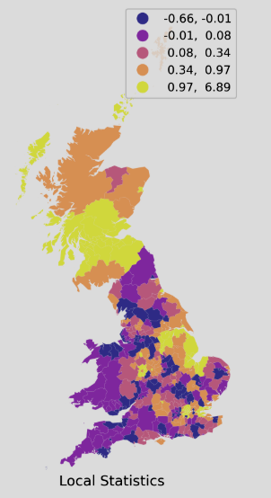
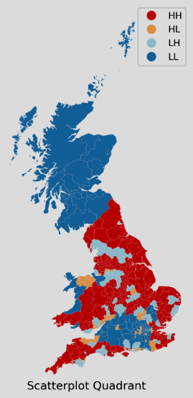
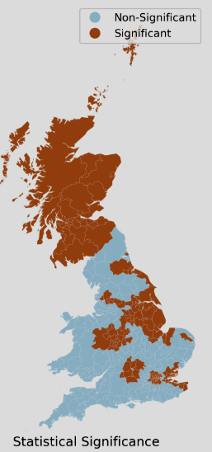
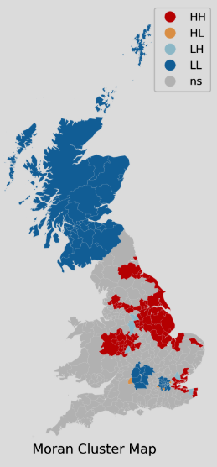
Interpreting Results

Slide 35
Frequency Table
Category | Count | Percentage
Non-Significant | 226 | 59.47%
HH | 75 | 19.74%
LL | 69 | 18.16%
LH | 6 | 1.58%
HL | 4 | 1.05%

Slide 36
Your turn

Slide 37
Getis Ord
Getis-Ord Gi* is a local spatial statistic used to identify hot spots (high values surrounded by high values) and cold spots (low values surrounded by low values) in geospatial data.
✅ High Gi* → Hot spots (clusters of statistically high values).
✅ Low Gi* → Cold spots (clusters of statistically low values).
You can get both Gi and Gi*
The * includes whether you add yourself into the computation

Slide 38
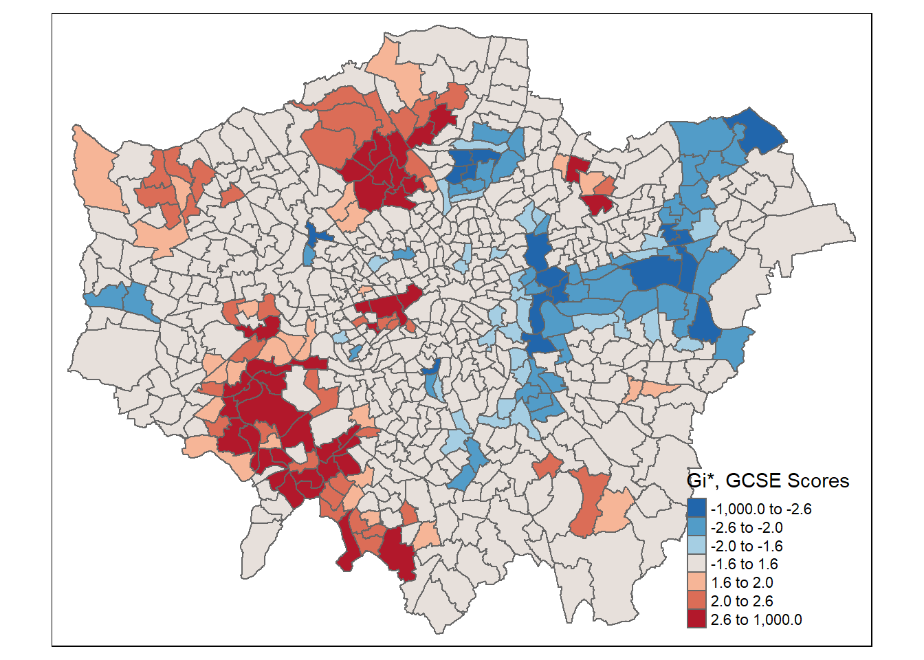
How it works
For each feature/location i, the Gi* statistic sums the attribute values of i and its neighbours, weighted by spatial proximity.
It then compares this local sum to the global sum of all attribute values.
The result is a Z-score, which tells you whether high (or low) values are spatially clustered.
Notes:
🧠 How It Works:
For each feature/location iii, the Gi* statistic sums the attribute values of iii and its neighbours, weighted by spatial proximity.
It then compares this local sum to the global sum of all attribute values.
The result is a Z-score, which tells you whether high (or low) values are spatially clustered.

Slide 39
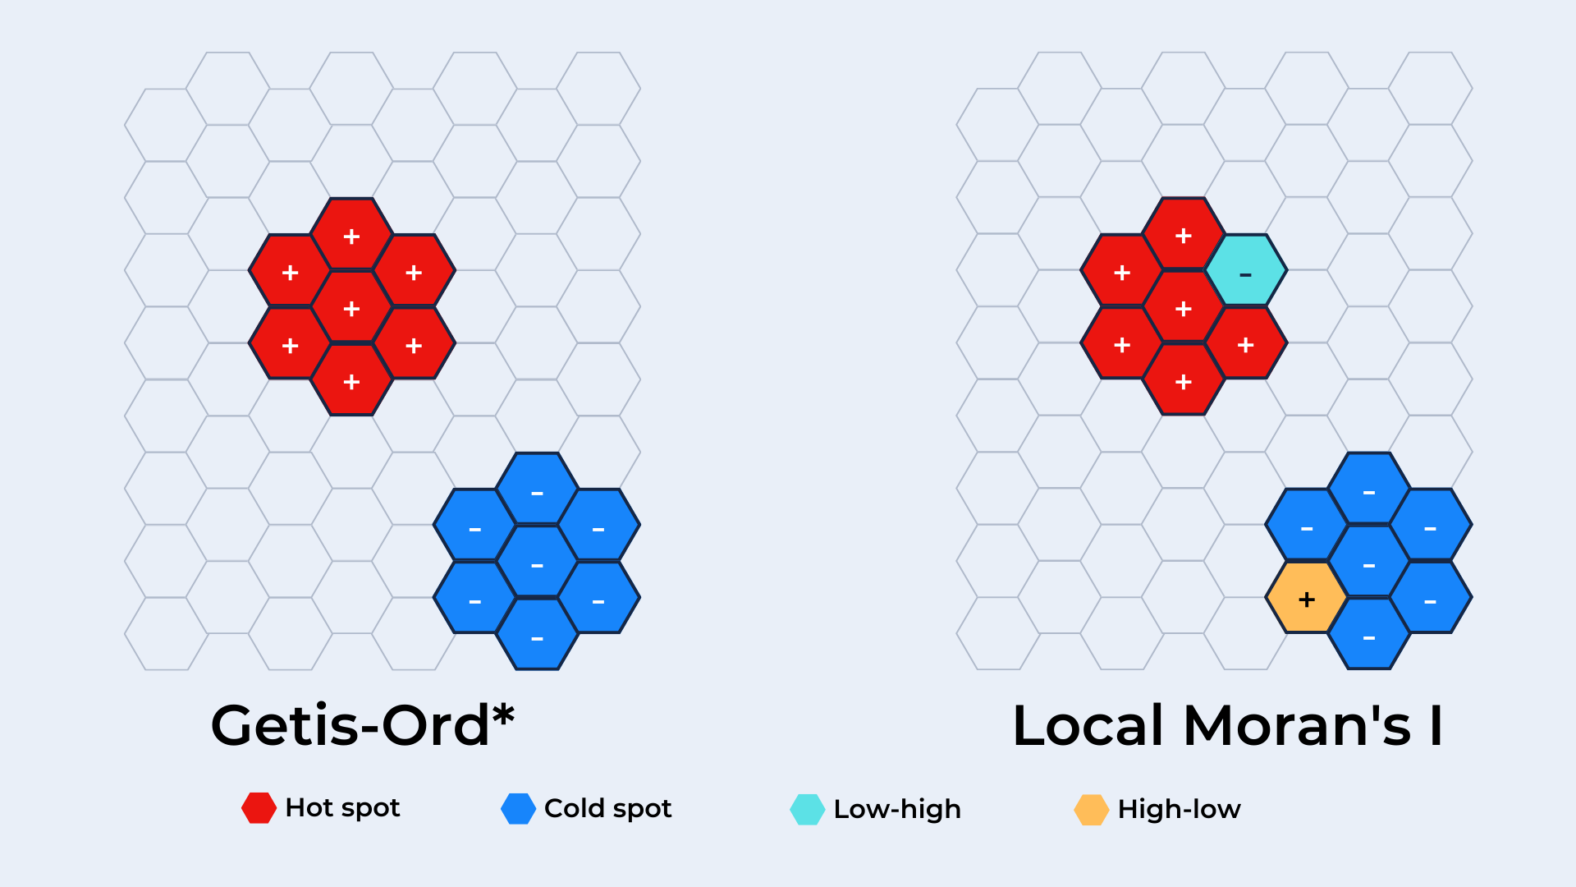
LISA vs Getis Ord
Feature | Local Moran’s I | Getis-Ord Gi*
Type | Local measure | Local measure
Measure | Similarity/dissimilarity between a location and its neighbours | Intensity of clustering of high or low values
Purpose | Detects overall spatial autocorrelation | Identifies hot/cold spots
Detects | Clusters and spatial outliers | Only clusters (hot/cold spots)
Based on | Deviation from mean | Sum of weighted values in neighbourhood
Notes:
🔥 Getis-Ord Gi* – Hot Spot Analysis in Spatial Statistics
✅ Purpose:
To identify statistically significant clusters of high or low values in a spatial context — commonly referred to as hot spots (high values) and cold spots (low values).

Slide 40
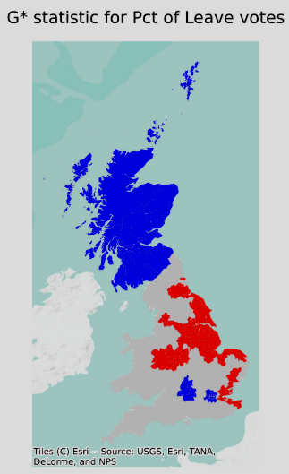
Gi* Example

Slide 41
Example Use Cases for Getis-Ord Gi*
Crime Analysis – Identifying crime hot spots for targeted policing.
Urban Planning – Locating areas needing infrastructure investment.
Public Health – Detecting disease outbreak clusters.
Retail Analysis – Finding high-density consumer areas.

Slide 42
Your turn

Slide 43
Lecture Summary
Spatial Weights: Define proximity (contiguity, distance-based)
Spatial Autocorrelation: Measures how similar values cluster in space
Global Moran’s I: Detects overall clustering (HH, LL = positive; HL, LH = negative)
Local Moran’s I (LISA): Finds local clusters/outliers (HH, LL, HL, LH)
Getis-Ord Gi*: Identifies hot and cold spots
Use: Map patterns, test hypotheses, guide spatial decisions

Slide 44
Questions?
If not, I will all see you tomorrow with some example data

Slide 45
Reference
Ray et al (2023), Geographic Data Science with Python, CRC Press
Fleischmann (2024), Spatial Data Science in Python
Dorman, M., Graser, A., Nowosad, J., & Lovelace, R. (2025). Geocomputation with Python. CRC Press

